Slide 1
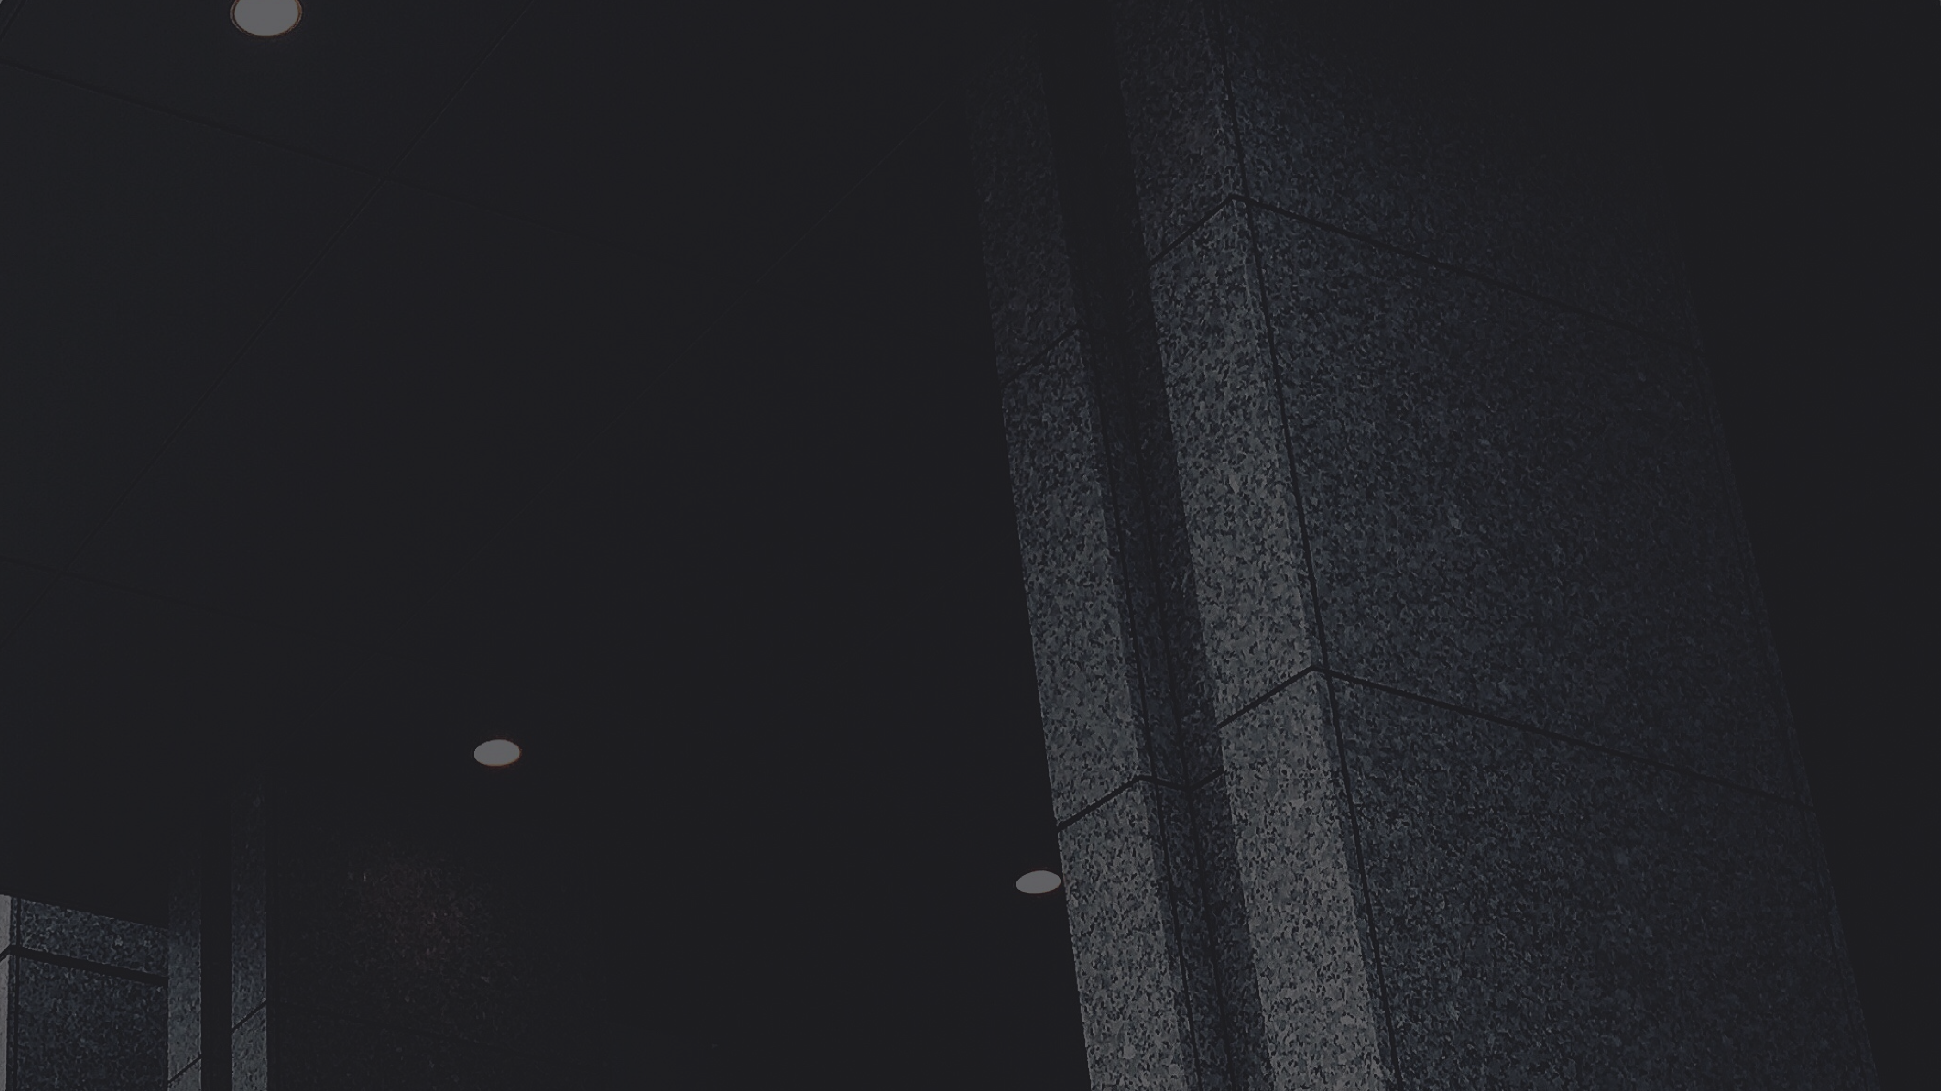
MINESWEEPER
T/R
SEPTEMBER 1, 2025
Members:
Nguyen Minh Trang - ITDSIU19020 Phan Vo Phuong Tung - ITDSIU19025 Le Thi Thu Tra - ITDSIU19058
Tran Huu Phuc - ITDSIU19013

Slide 2
01
INTRODUCTION
02
CLASSES DESIGN
03
ALGORITHM IMPLEMENTIOM
Outline
04
DEMO
05
CONCLUSION

Slide 3

INTRODUCTION
A brief introduction about minesweeper game
MINESWEEPER IS A SINGLE-PLAYER PUZZLE VIDEO GAME.
THE OBJECTIVE OF THE GAME IS TO CLEAR A RECTANGULAR BOARD CONTAINING HIDDEN "MINES" OR BOMBS WITHOUT DETONATING ANY OF THEM, WITH HELP FROM CLUES ABOUT THE NUMBER OF NEIGHBORING MINES IN EACH FIELD.
THE GAME ORIGINATES FROM THE 1960S, AND IT HAS BEEN WRITTEN FOR MANY COMPUTING PLATFORMS IN USE TODAY.
IT HAS MANY VARIATIONS AND OFFSHOOTS

Slide 4
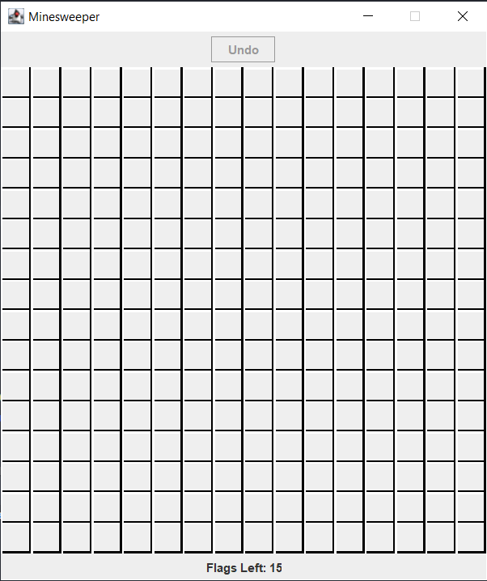
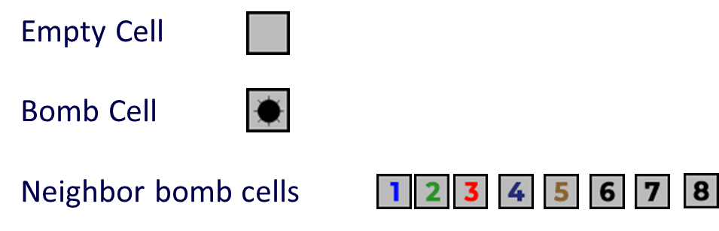
INTRODUCTION
A brief information about game rule:
The objective is to clear all the “mines'' or bombs from a minefield by flagged the cell that can be a mine cell. The number of flags equal the number of mines
01
02
Right click to mark that cell
03
Left click to reveal the cells. It can be:
04

Slide 5
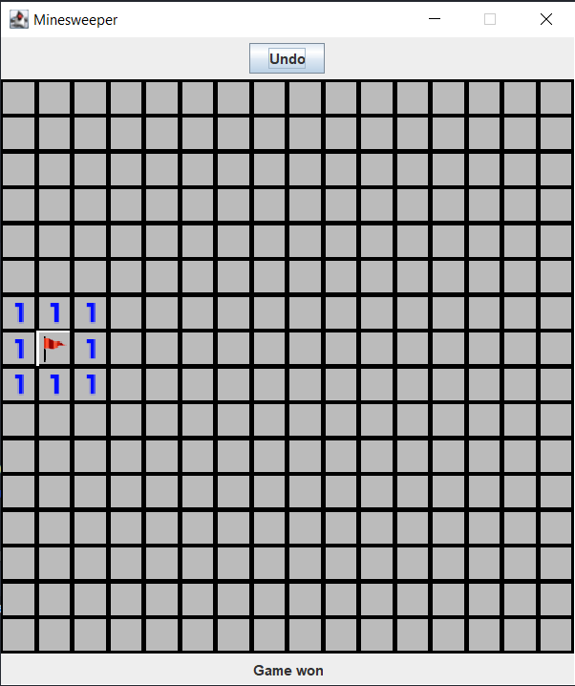
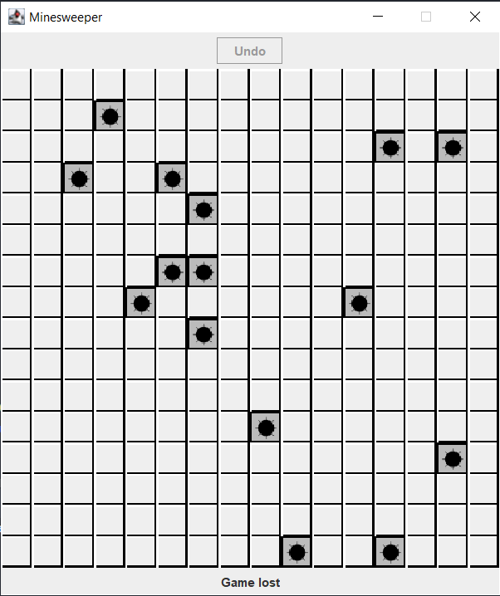
INTRODUCTION
A brief information about game rule:
03
04
WIN
LOSE
When mark all mines cell
Click on the mines

Slide 6
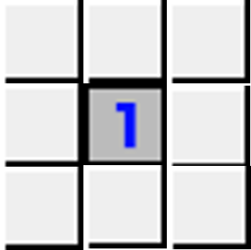
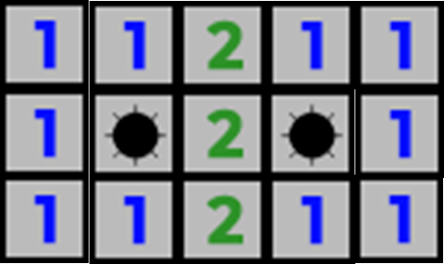
INTRODUCTION
Hint:
One of these maybe bomb
2 means it touch 2 mines

Slide 7

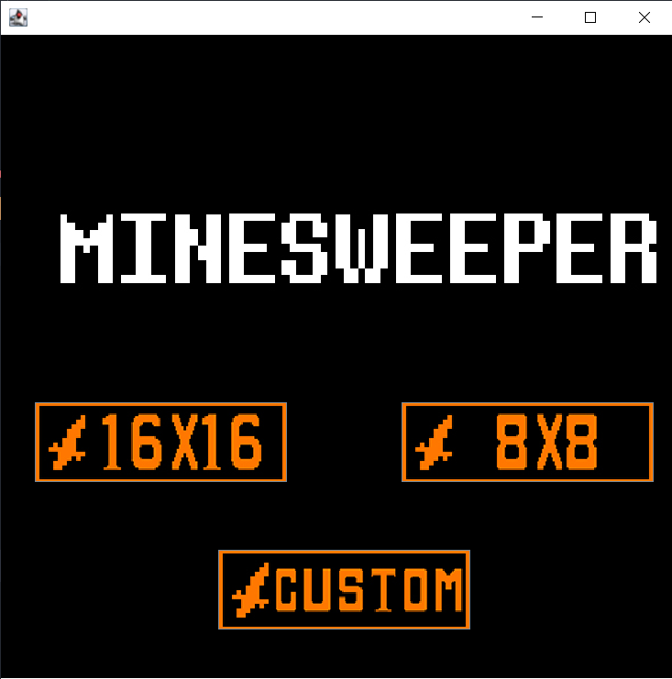
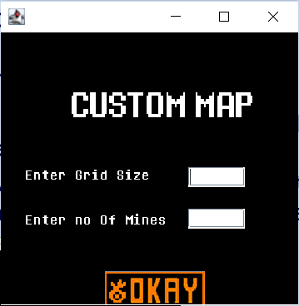
INTRODUCTION
Extra Feature:
- Undo: let user return the previous step by clicking the Undo button
- Custom Map: let user choose size of the minefield. There are 8x8, 16x16 and custom which user can set the size and number of mines

Slide 8
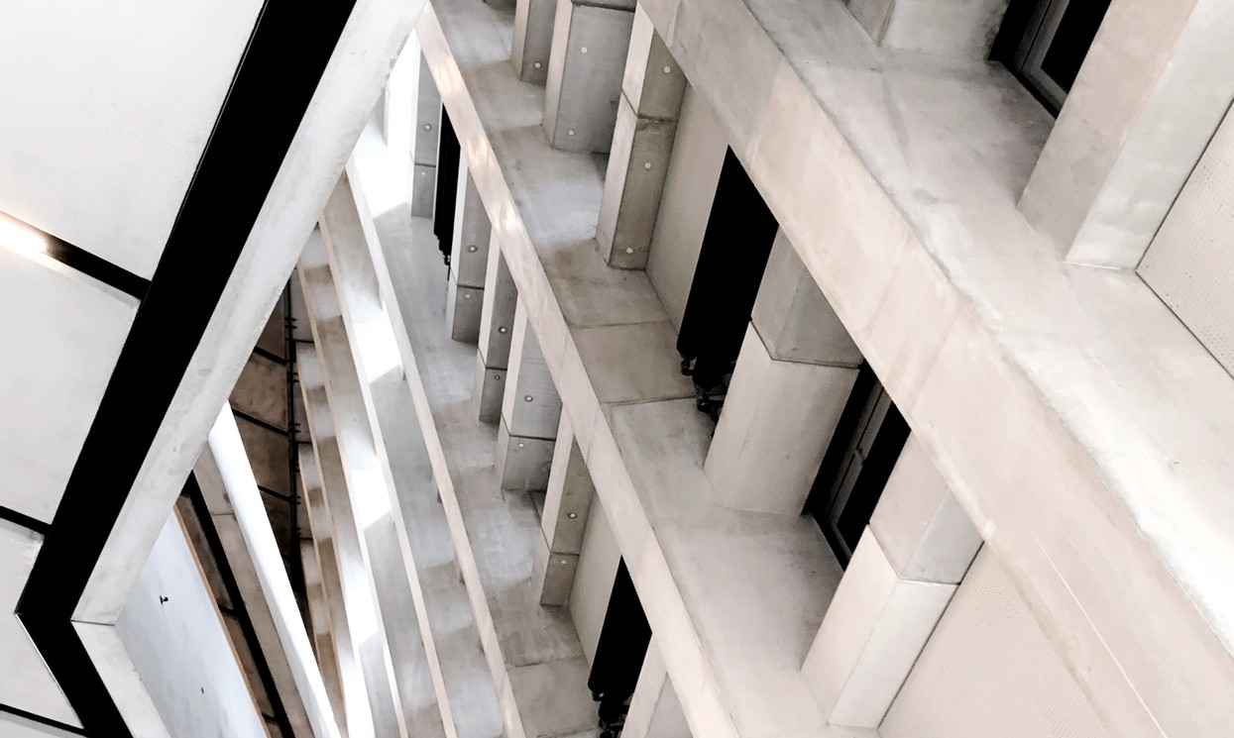

Game.java
Cell.java
Board.java
CellType.java and ImageName.java
Input.java and CustomMap.java
ClASSES DESIGN
FULL UML VIEW

Slide 9
ALGORITHM
2D ARRAY
COLLECTION
RECURSION

Slide 10
ALGORITHM
2D ARRAY
We used a 2-D array of “Cell” objects to considered as the grid to store the state of each cell in that grid in terms of which cells contain bombs, if they are empty, or if they are neighbor of bomb cells (i.e “number’ cells).
The 2-D array was used whenever a new game was started, in which the 2-D array would be randomly filled with bomb cells, number cells (, or empty cells

Slide 11
ALGORITHM
COLLECTION
We fully take advantage of the LIFO property of Stack so it would be best for us to implement that principle to store the players’ move in order to undo the most recent step by popping it out of the Stack (undo is an undate feature)
The other function of Stack - push() is also used to add steps to the Stack whenever the player left-click a number of empty cells, and right-click to flag/unflag a cell, which shows the player’s most recent move.

Slide 12
ALGORITHM
RECURSION
We utilize recursion to reveal and clear a mine-free region of cells. In other words, when a player clicks on a cell that has no bombs with adjacent cells also bomb-free so all adjacent cells are automatically cleared and the region with bomb-free cells is revealed up until the cell that is connected to a bomb.

Slide 13

CONCLUSION
We need to improve more advanced features other than undo and choose menu like score system, time system, apply some good- looking design patterns into the code
The project helps us know how to build a proper game with add-on features like undo… Also how to
apply recursion, linked list into classes.
The project was designed simple, with just letting the user choose the size of the board and play the game based on their choice.

Slide 14
REFERENCES
https://www.w3schools.com/java/java_recursion.asp
https://www.geeksforgeeks.org/stack-class-in-java/
https://www.microsoft.com/vi-vn/p/microsoft-minesweeper/9wzdncrfhwcn?activetab=pivot:overviewtab
https://www.instructables.com/How-to-play-minesweeper/
https://minesweeper.online/game/697203744
https://github.com/nmaguirre/minesweeper
https://stackoverflow.com/questions/32735206/java-png-exception

Slide 15
Thank you!
T/R

